Slide 1
Strings
Pratik Zadafiya
Rudra Thakkar
Shahrbanoo Gholami
Sreyas Menon

Slide 2
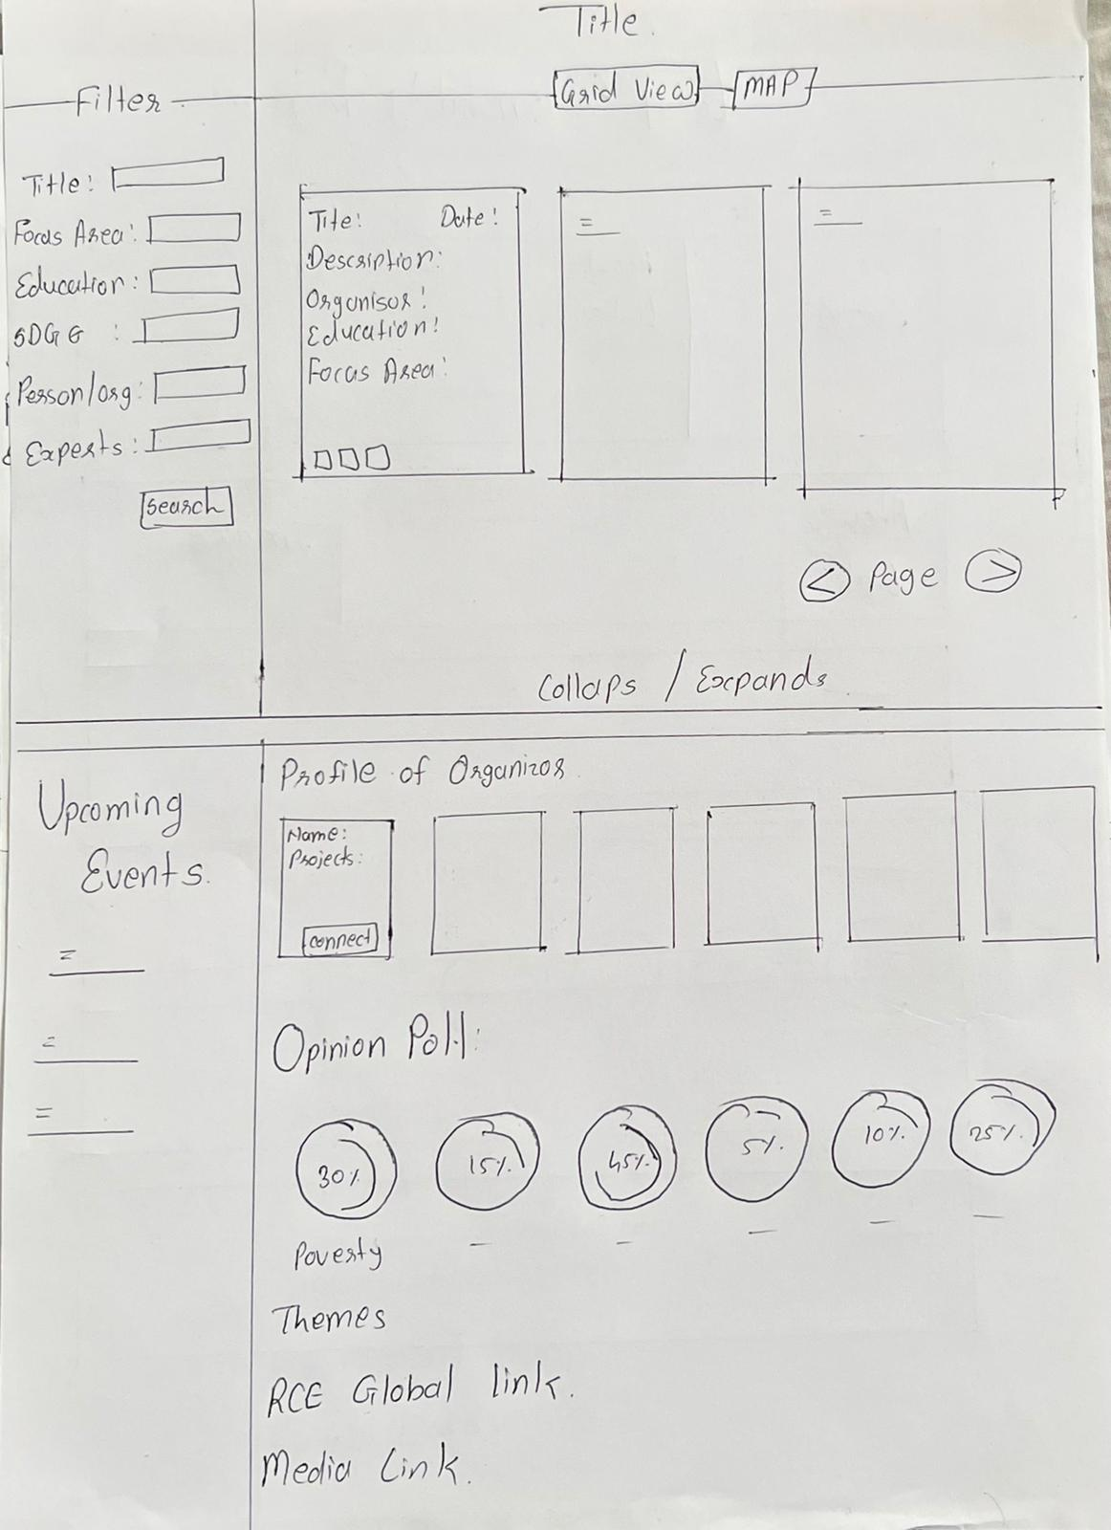
Prototype 1

Slide 3
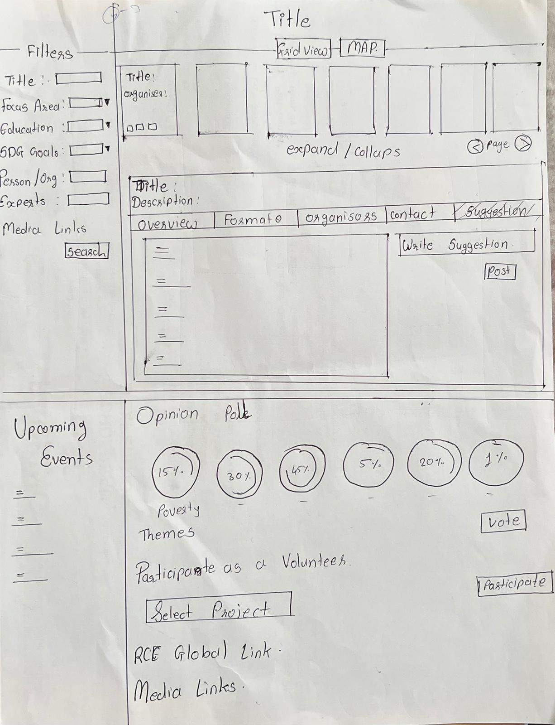
Prototype 1

Slide 4
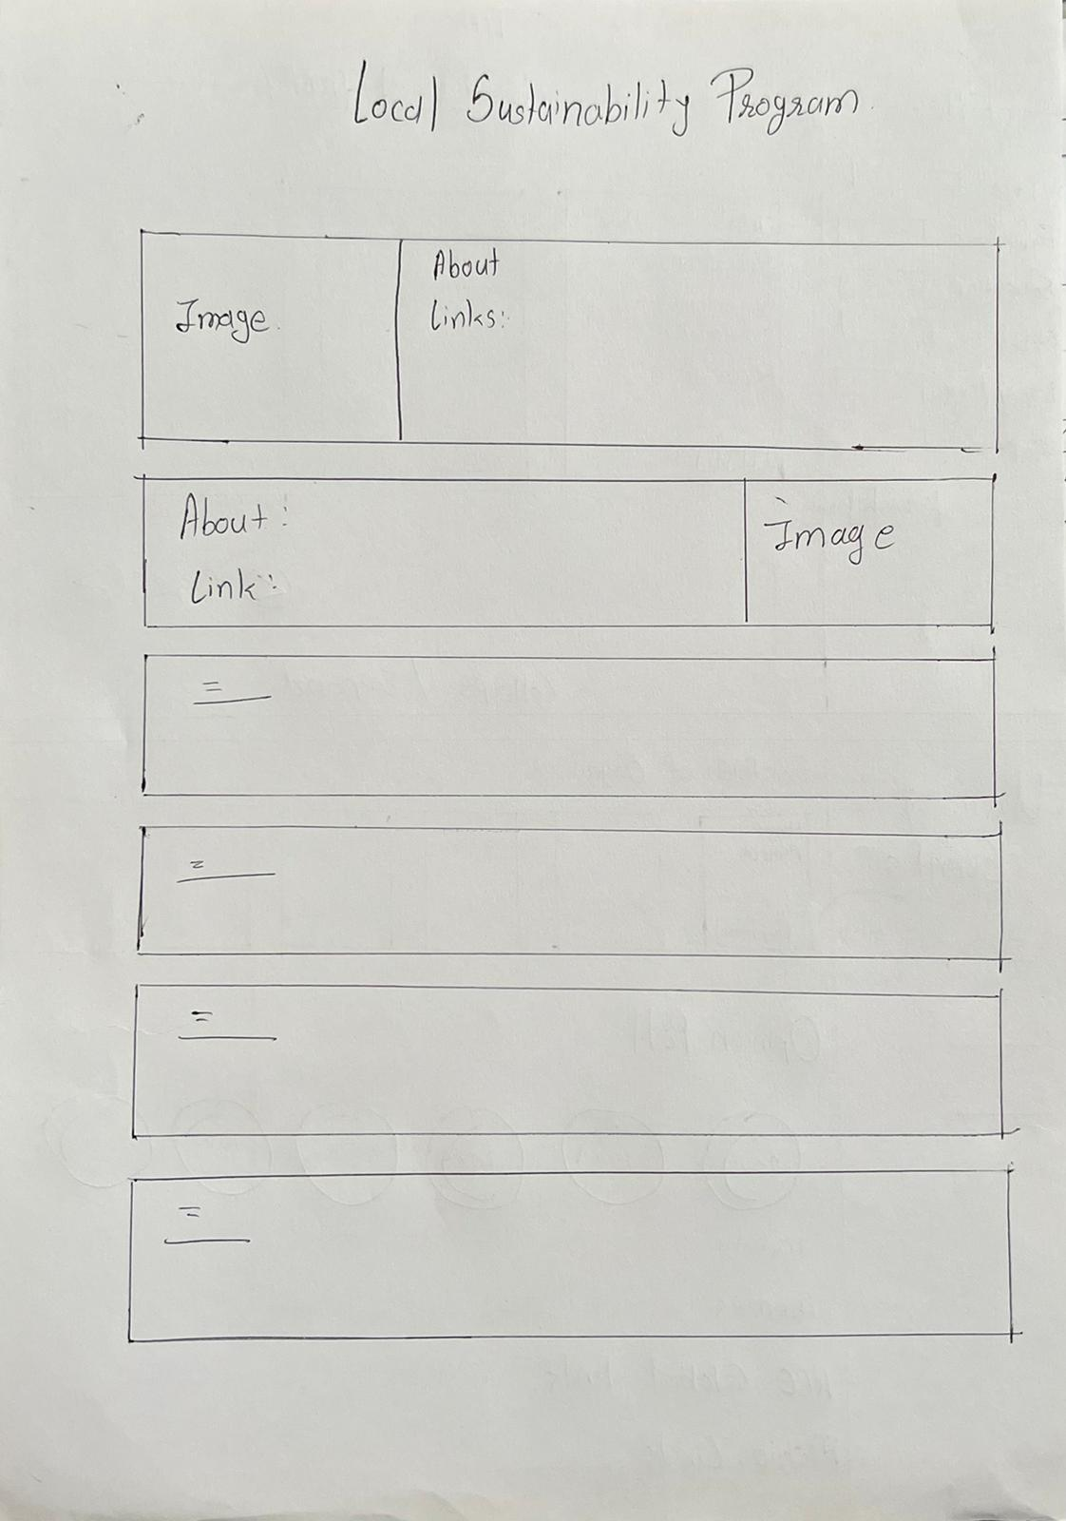
Prototype 1

Slide 5
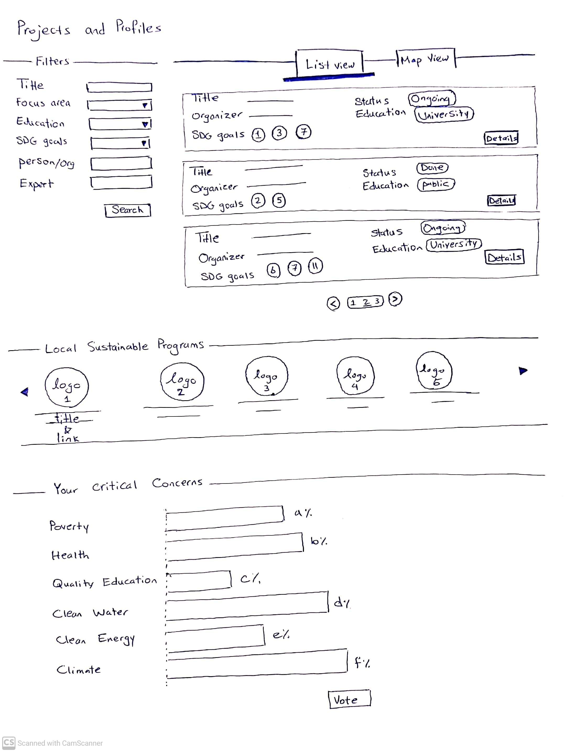
Prototype 2

Slide 6
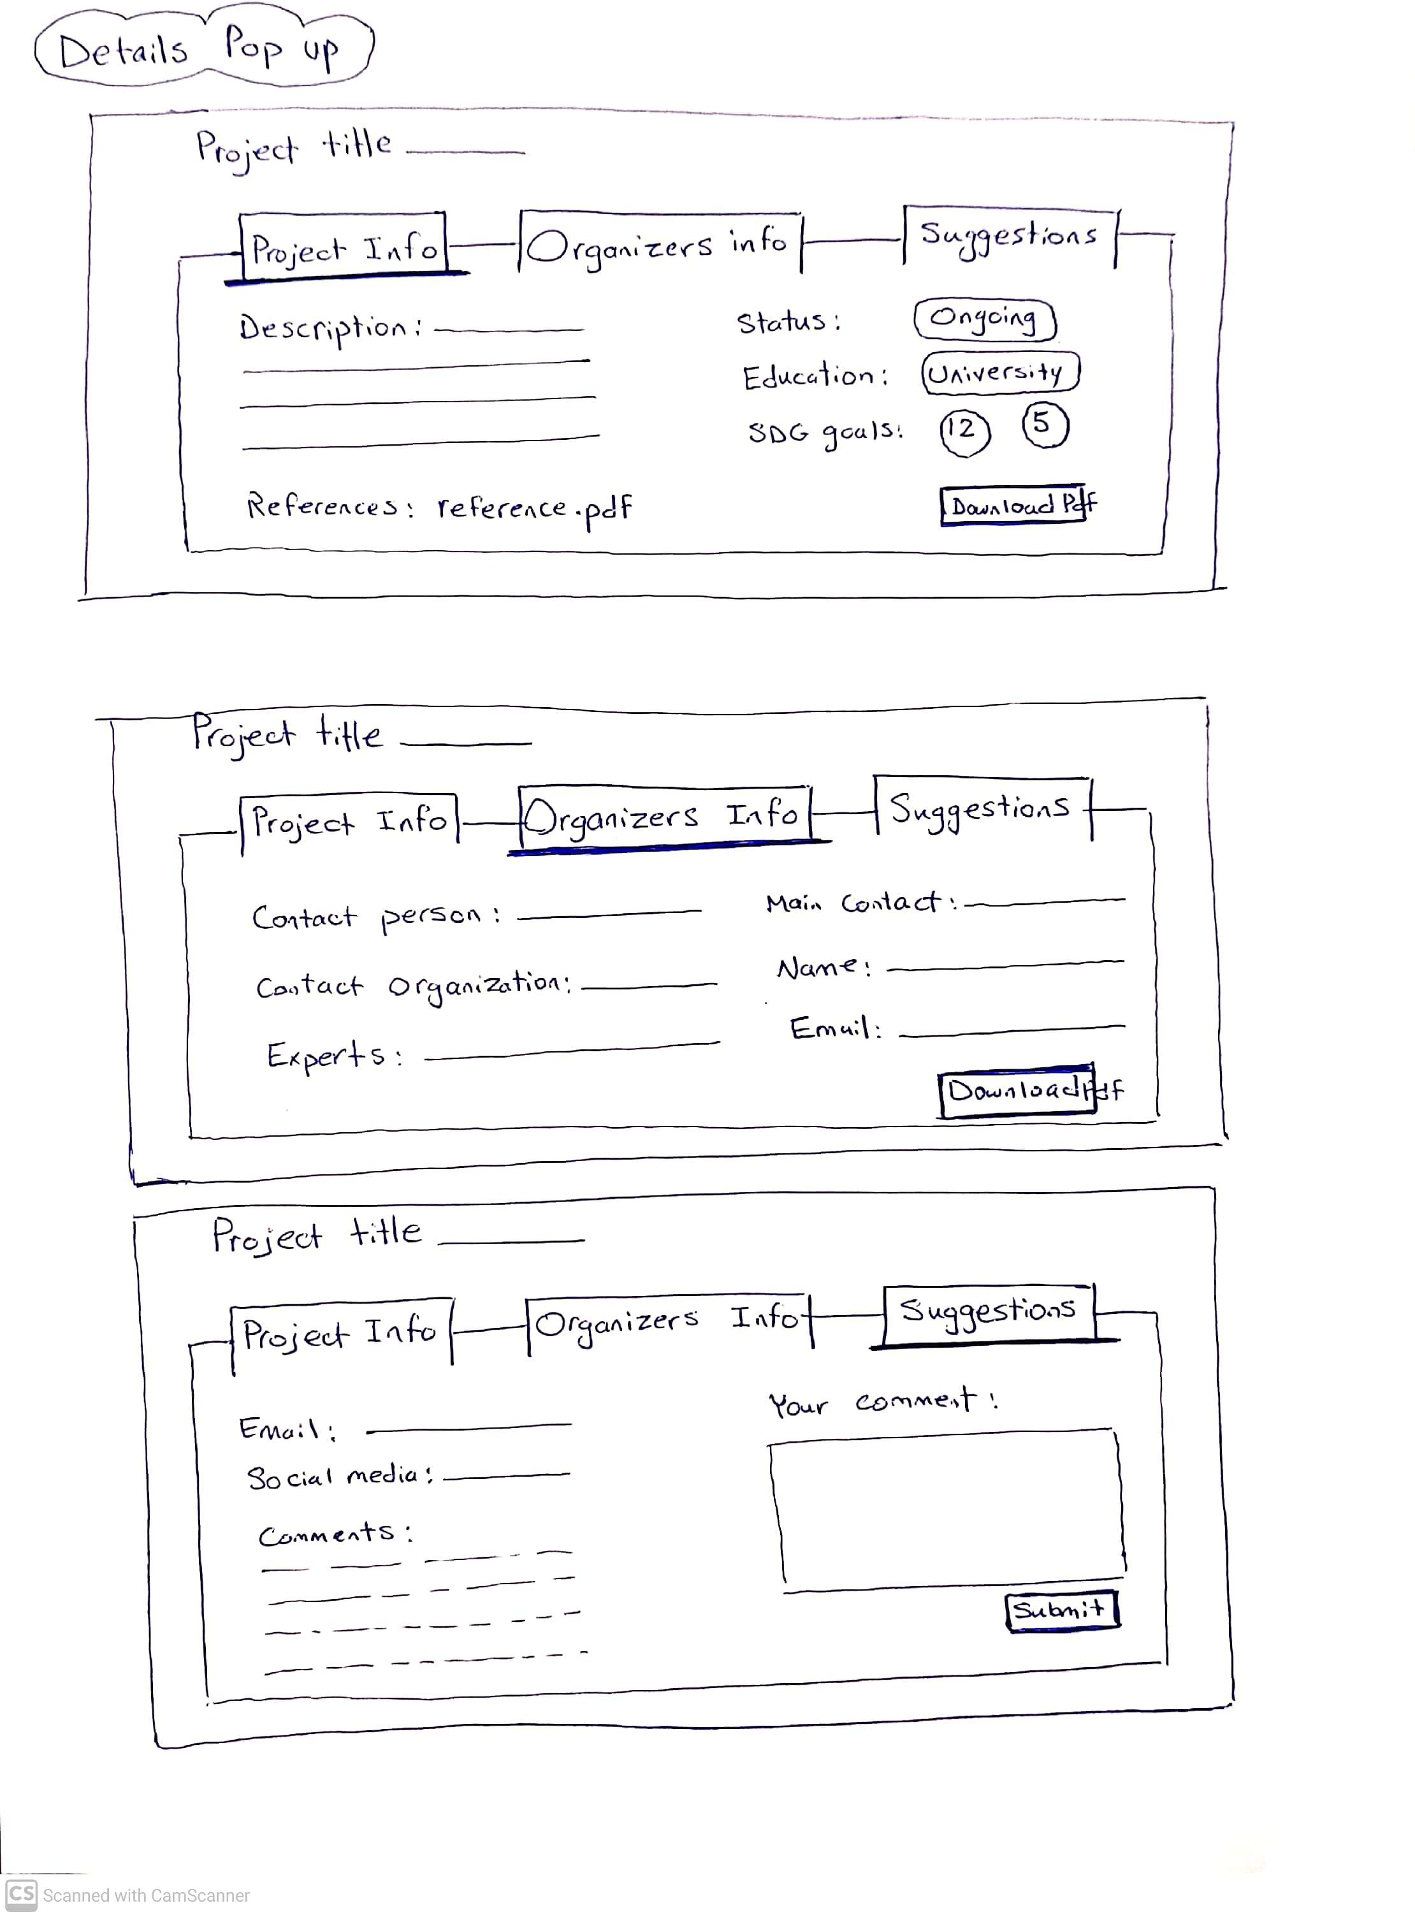
Prototype 2

Slide 7
Prototype 3

Slide 8
Prototype 3

Slide 9
Prototype 3

Slide 10
Prototype 3

Slide 11
Prototype 3

Slide 12
Prototype 4

Slide 13
Prototype 4

Slide 14
Prototype 4

Slide 15
Prototype 4

Slide 16
Prototype 4

Slide 17
Prototype 4

Slide 18
Prototype 4

Slide 19
Prototype 4

Slide 20
Thank you

